Slide 1
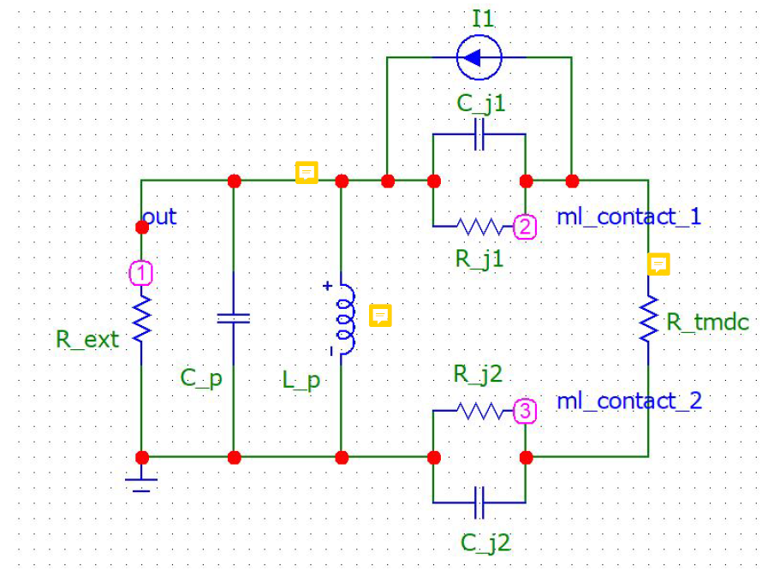
What was base values from which you the sweep was done?

Slide 2
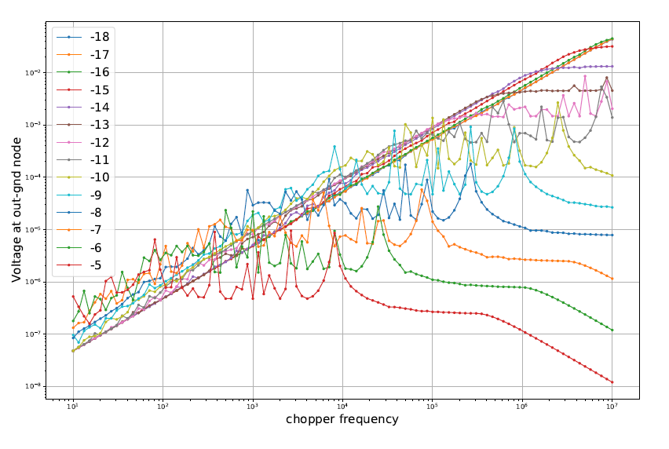
Open circuit; Lock-in measures voltage
Low frequencies
Cp
Upto Cp = 10-9 we are safe with our usual chopper

Slide 3
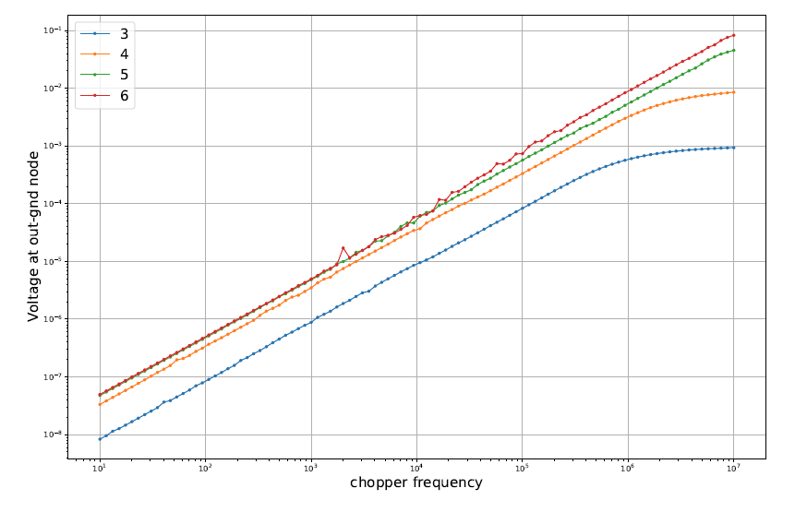
Open circuit; Lock-in measures voltage
Low frequencies
Rj
Apparently, for higher junction resistance we have the better the signal

Slide 4
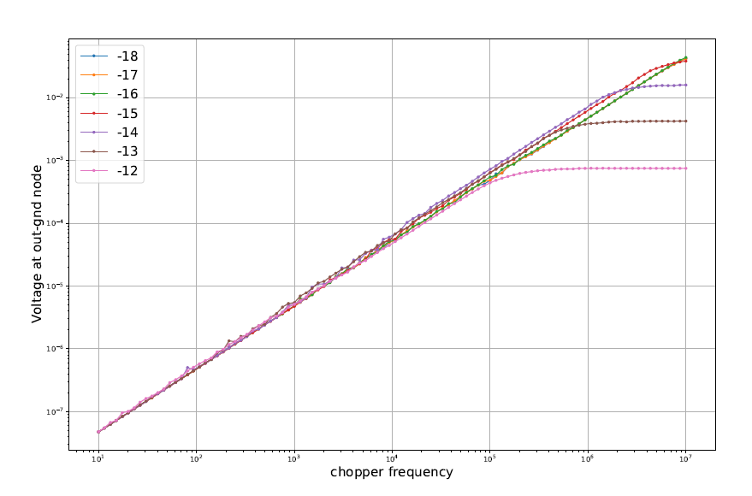
Open circuit; Lock-in measures voltage
Low frequencies
Cj
Cj doesn’t influence our signal since capacitance is dominated by Cp. Even high frequencies are almost intact for Cj< 1E-15

Slide 5
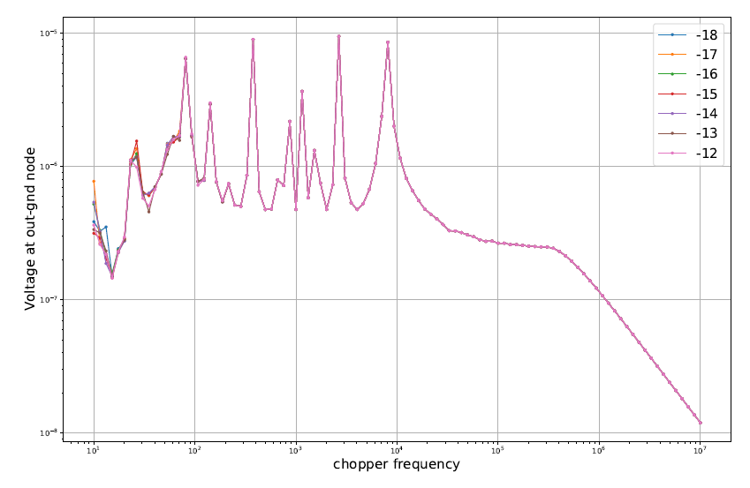
Open circuit; Lock-in measures voltage
Low frequencies
Cj
Once system is fucked it is fucked and Cj cannot help it
At Cp=1e-5

Slide 6
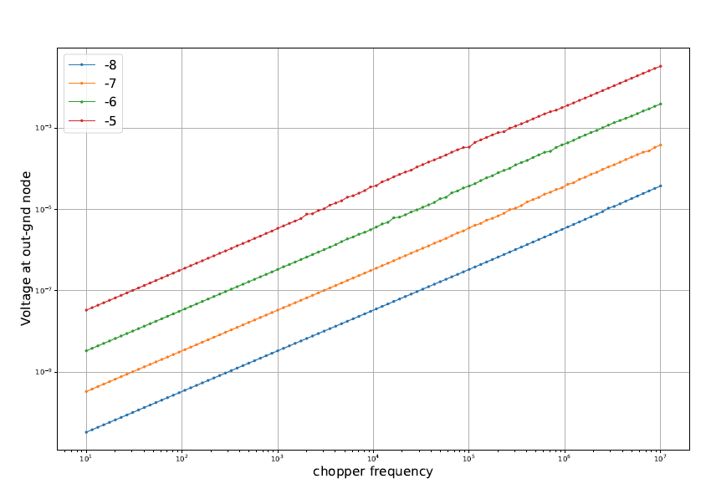
Open circuit; Lock-in measures voltage
Low frequencies
Lp
High Lp helps signal? Probably we should try adding some inductance to our scheme

Slide 7
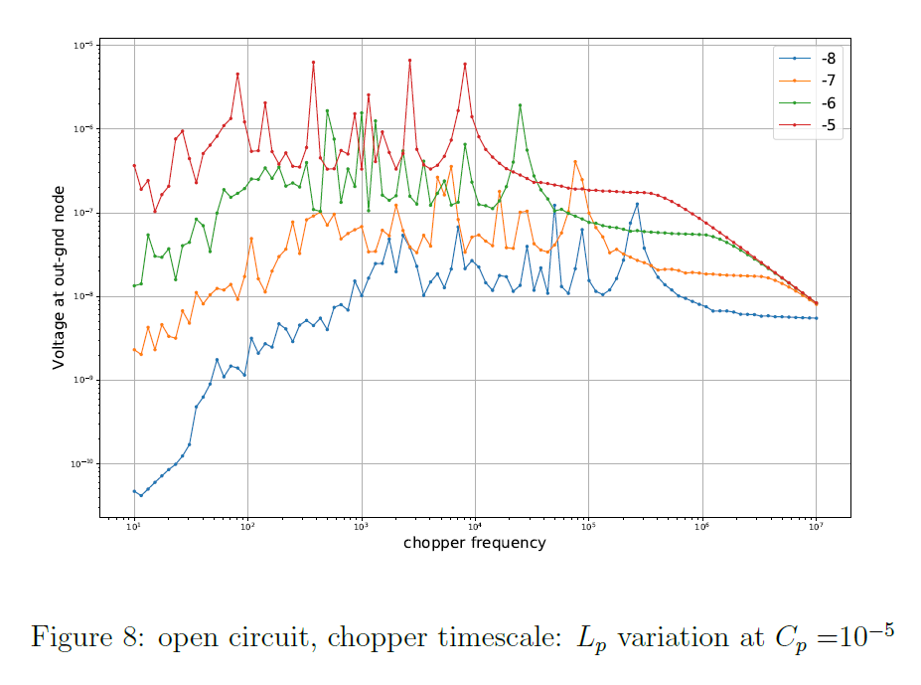
Open circuit; Lock-in measures voltage
Low frequencies
Lp
If we think that signal is fucked due to Cp we can try to recover it by Lp

Slide 8
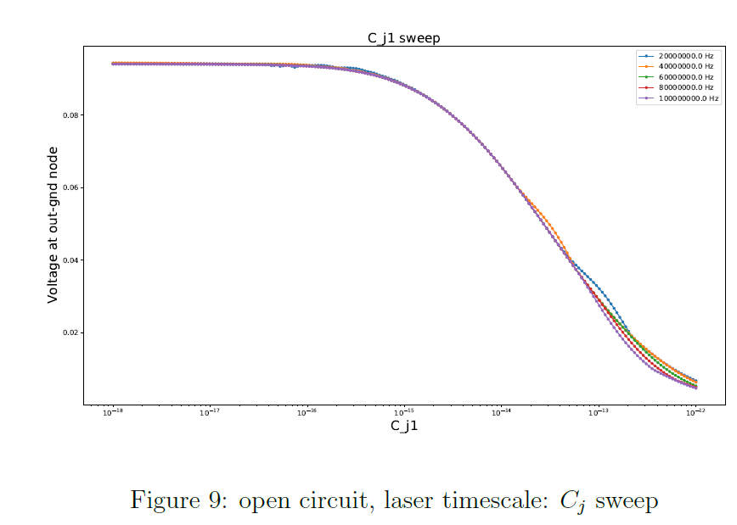
Open circuit; Lock-in measures voltage
High frequencies
Cj
With junction capacitance at bellow 1E-15 we should be able to even resolve pulses

Slide 9
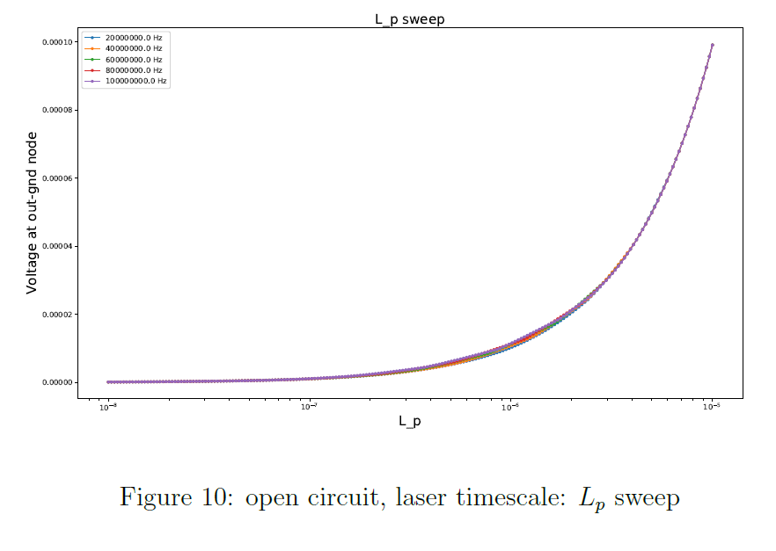
Open circuit; Lock-in measures voltage
High frequencies
Cj
In open circuit regime, increase of Lp leads to increase of high-frequency cut-off of the scheme

Slide 10
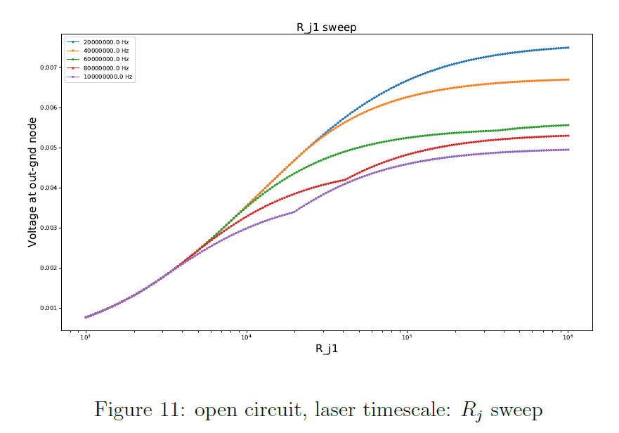
Open circuit; Lock-in measures voltage
High frequencies
High Rj also causes increase of high frequency cutoff

Slide 11
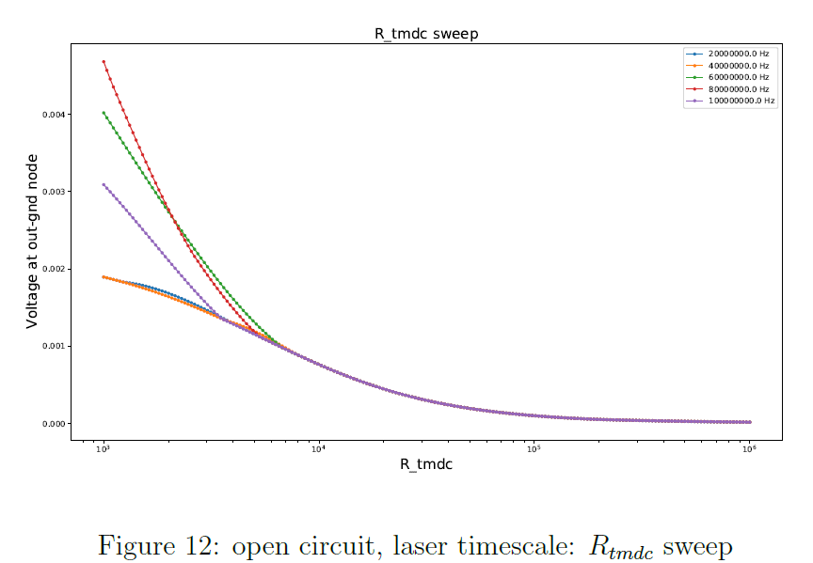
Open circuit; Lock-in measures voltage
High frequencies
Low flake resistance (high doping) increase high frequency respons by a lot. Apparently higher frequencies are more responsive to the flake resistance

Slide 12
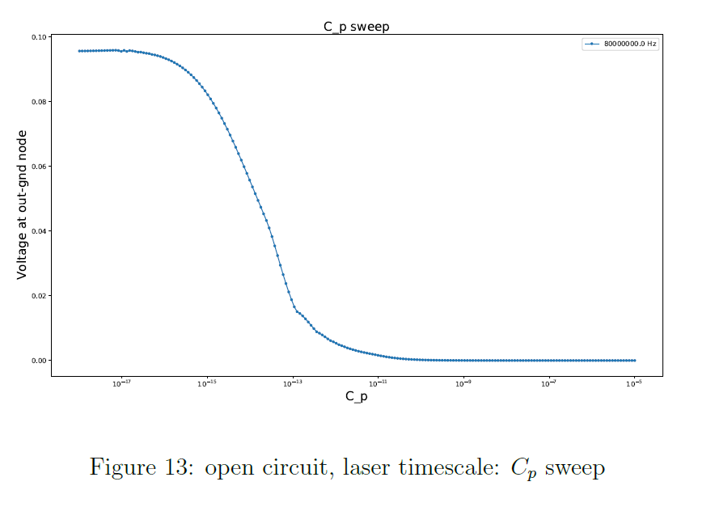
Open circuit; Lock-in measures voltage
High frequencies
All this highfreqieny stuff makes sense only if we can keep Cp below 1E-15 (for open circuit)

Slide 13
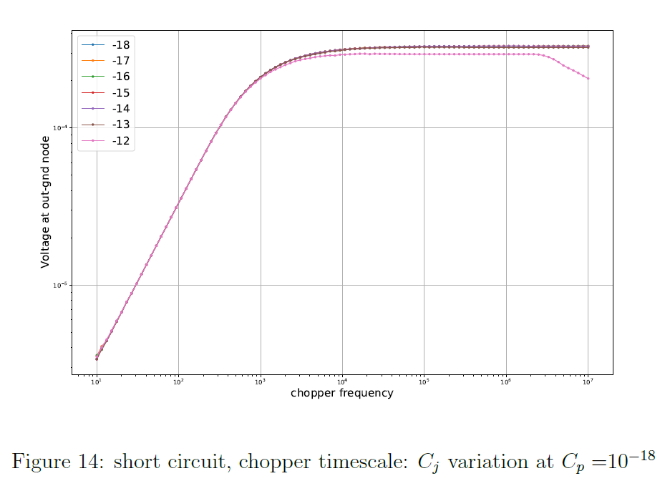
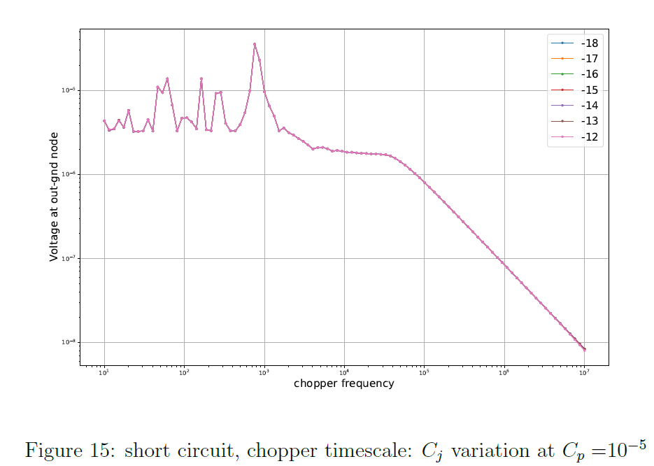
Short circuit; Lock-in measures current
High frequencies
For short circuit, contact capacity doesn’t influence signal much

Slide 14
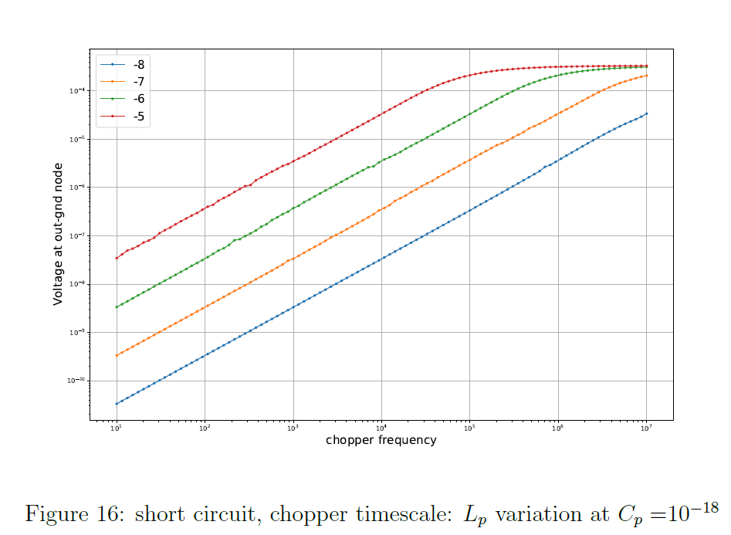
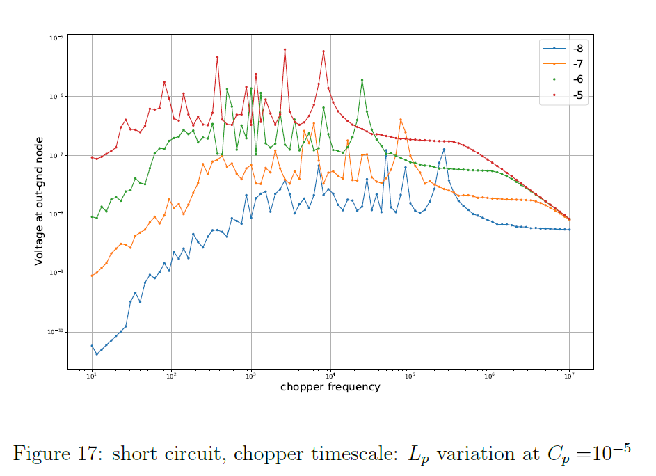
Short circuit; Lock-in measures current
High frequencies
The same behavior with Lp for short circuit. The higher Lp the better for realistic copper frequencies

Slide 15
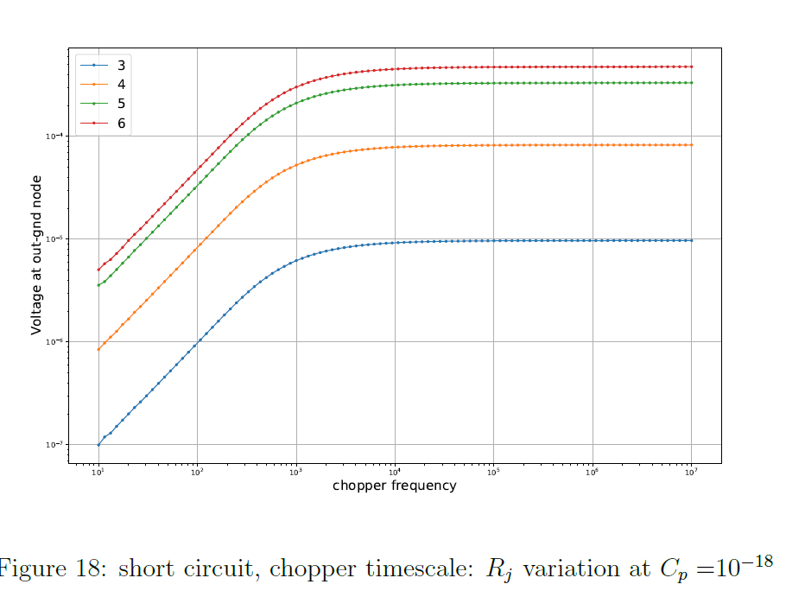
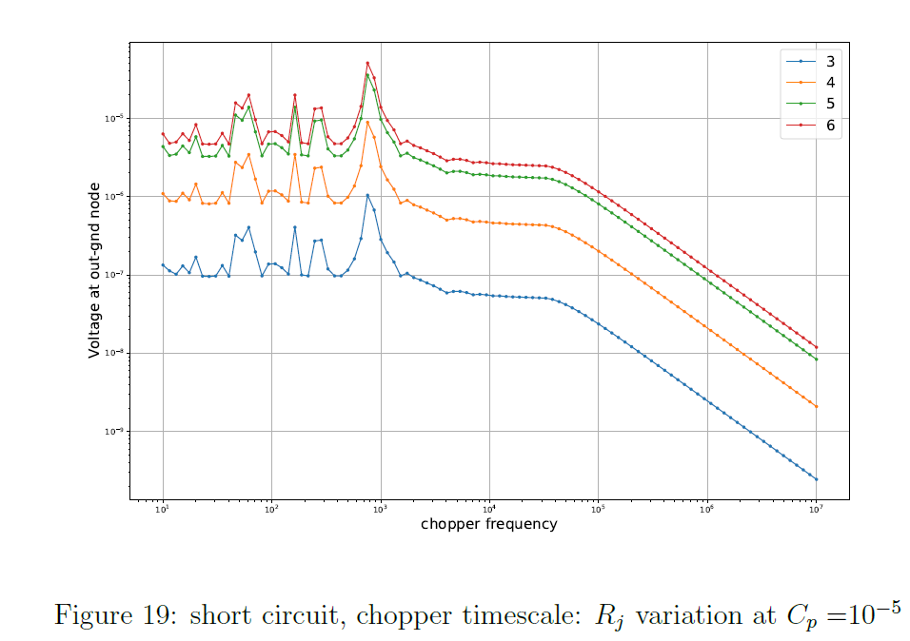
Short circuit; Lock-in measures current
High frequencies
Here we can see how high Rj kills signal (in case of short circuit) If we want to measure it in this way we should consider Gr or In electrods

Slide 16
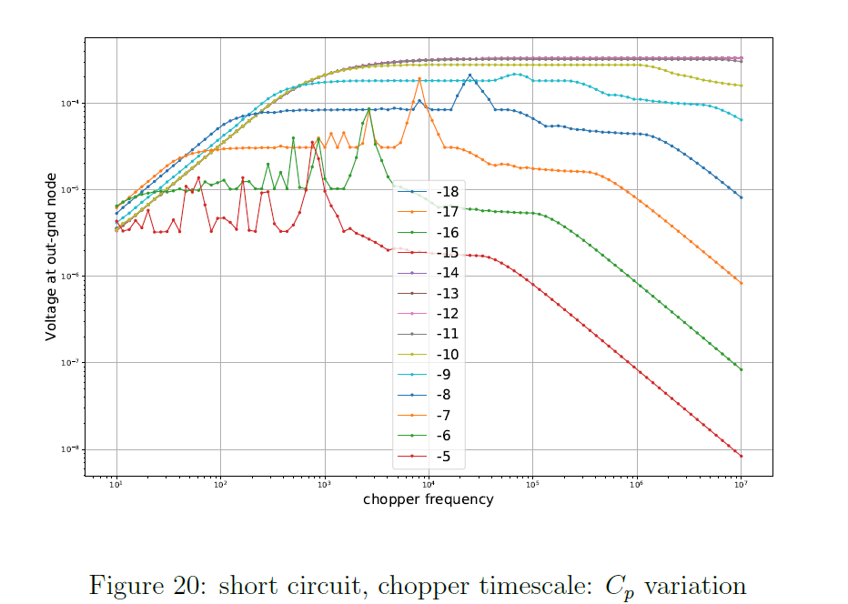
Short circuit; Lock-in measures current
High frequencies
Our ideal range

Slide 17
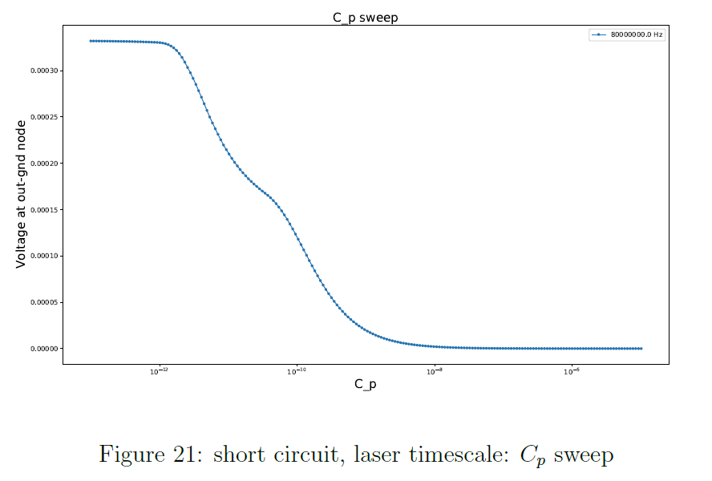
Short circuit; Lock-in measures current
High frequencies
In short circuit regime we may have additional high freqieuncy components ( inc. noise)

Slide 18
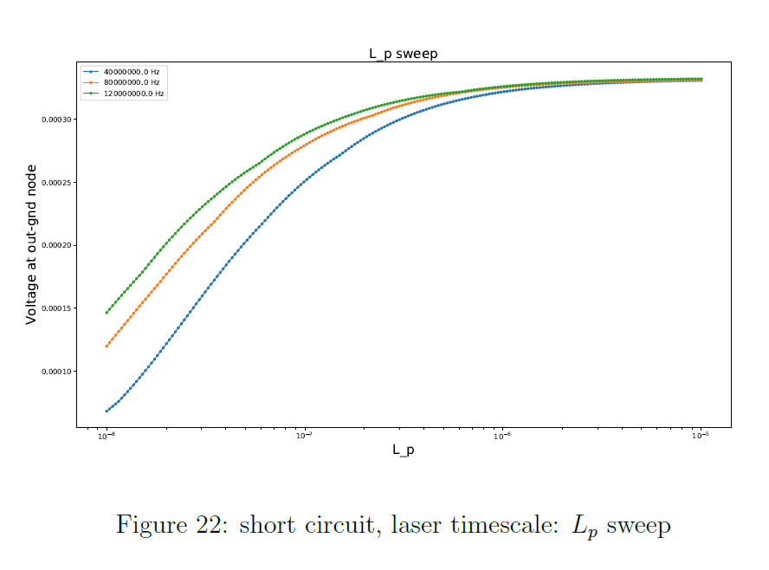
Short circuit; Lock-in measures current
High frequencies
Short circuit; Lock-in measures current
High frequencies

Slide 19
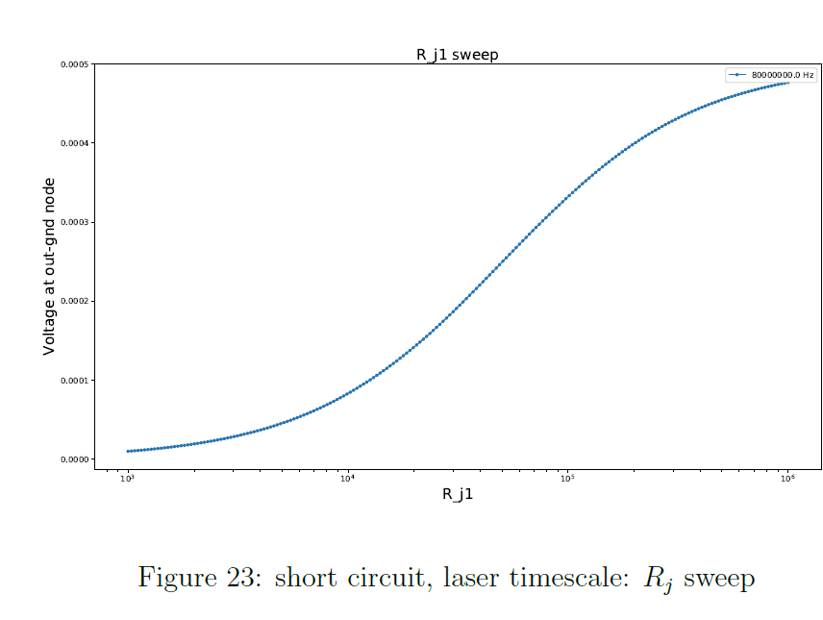
Short circuit; Lock-in measures current
High frequencies
Open and short circuits are similar in Rj dependence

Slide 20
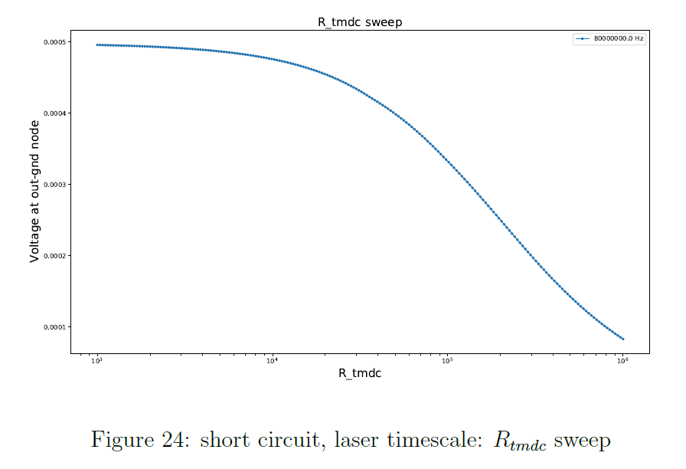
Short circuit; Lock-in measures current
High frequencies
Open and short circuits are similar in Rtmdc dependence
Low resistance -> more high-freqeuency components

Slide 21
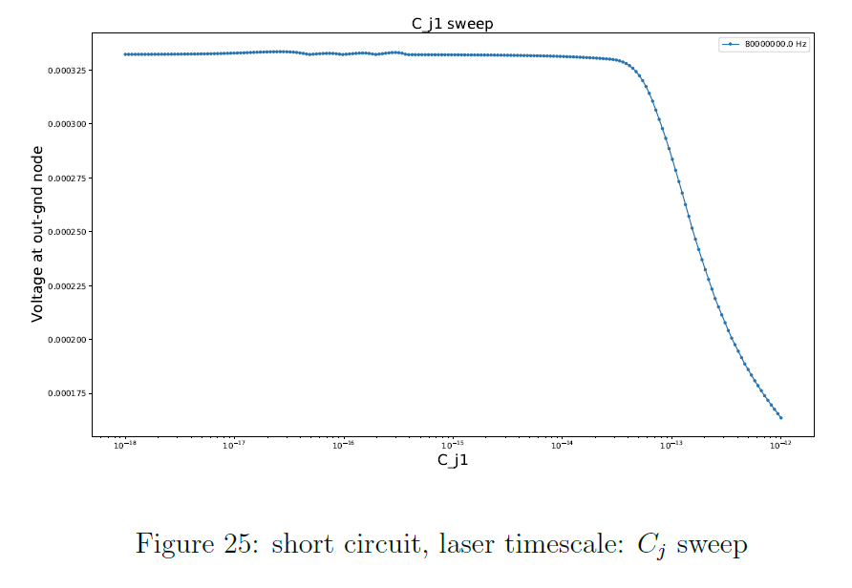
Short circuit; Lock-in measures current
High frequencies
Open and short circuits are similar in Cj dependence
However, the short circuit scheme signal is high even at 1E-14

